Slide 1

Accenture Women Hackathon 2015
Team Chip-Bin Presents

Slide 2

garboClean
dump cleaner for smart cities
garboClean is a waste monitoring solution that saves time, money and environment. It uses sensors to measure and forecast the fill-level of waste containers and generates smart routes to guide BBMP drivers. It features real time updates and analytics modules for smart planning for BBMP Managers

Slide 3


garboClean
Features
Easy to use App which supports both Android and iOS.
Increased fleet efficiency
Success factor
Zero cost Heuristic algorithm-minimum spanning tree for optimal route search
Optimal route resulting in time and cost savings
Real time fill and humidity status
Predicted fill up dates
Statistics
Alerts
Location /zone based labelled Bins for quick identification of Bins and improve speed of app.
Intuitive graphs for analysis
Low cost backend service provided using go daddy

Slide 4
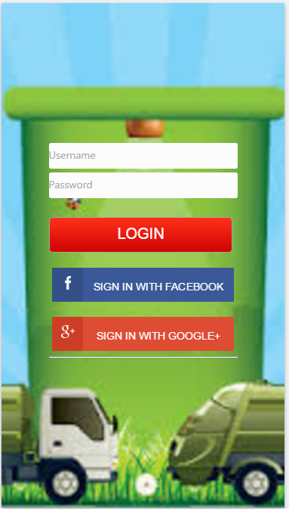
garboClean
How does it work ?
Login using your BBMP Registered email or your gmail / facebook login
App supports Driver and Supervisor Login

Slide 5
garboClean
Driver Module
Search based on Location /zone to get the Bins in the area
View Bin fill level and location details
Supervisor Module
Same features as Driver Module
get Optimal route for clearing filled bins
User can choose between 2 separate routes
Additionally can access Analytics module for comparative analysis on fill trends and empty trends of bins to help with predictive planning
View Bin details to analyse temperature/humidity for a week or custom period to help understand bin trends and help take effective decisions
Analytics graphs to help Supervisor understand trends take preventive measures and stay abreast of fleet concerns/ issues

Slide 6
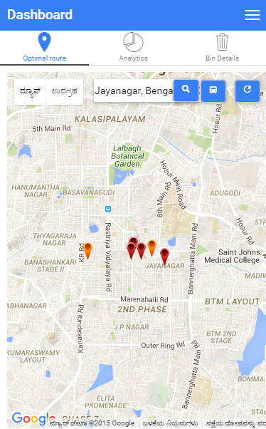
garboClean
Type zone /Location and Search to get the Bins
Click on the Bus Icon to get the Route
Bins in your selected Zone is shown with real time fill levels. Color Red bin indicates high fills

Slide 7
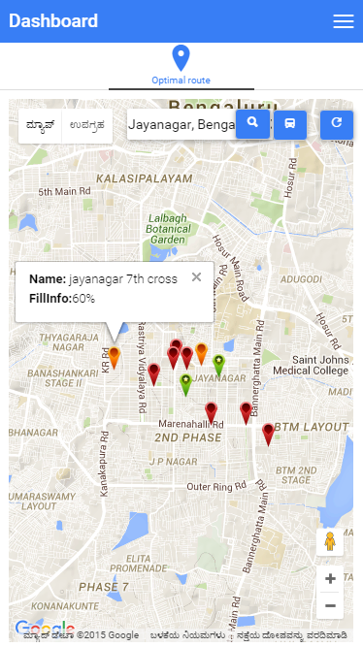
garboClean
Hover to get Bin Details
click on Bin to to go Bin Details screen

Slide 8
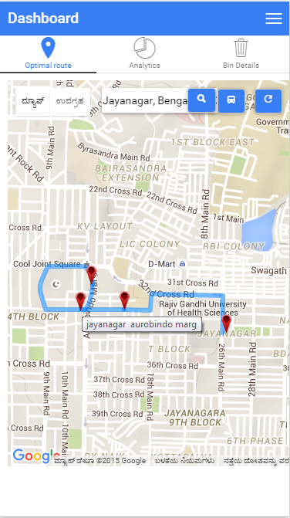
garboClean
Localized to Kannada for BBMP
Get optimized route to pick only filled bins

Slide 9
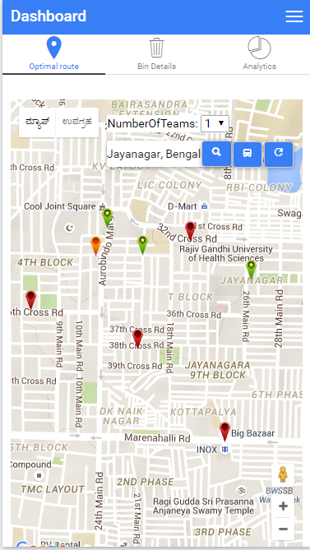
garboClean
Select NumberofTeams from drop down to get split routes for Teams

Slide 10
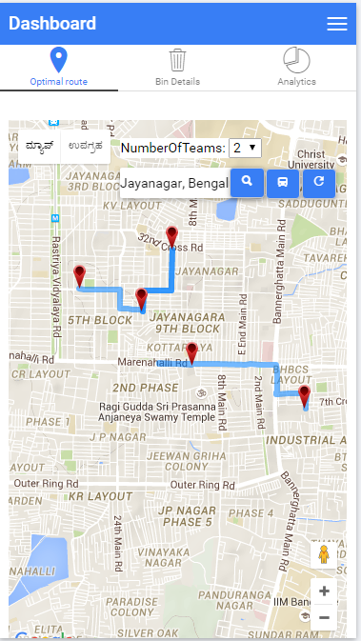
garboClean
Two separate routes are generated when Number ofTeams is set as 2

Slide 11
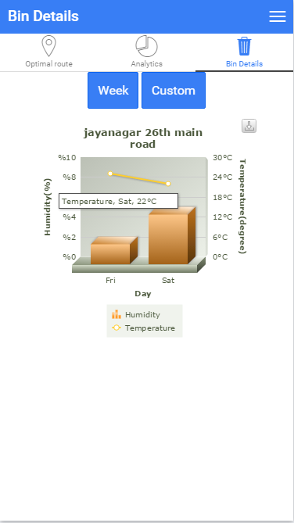
garboClean
You can view weekly statistics or for a custom period
View real time Bin Temperature and Humidity levels

Slide 12
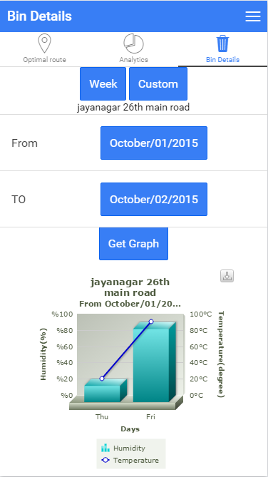
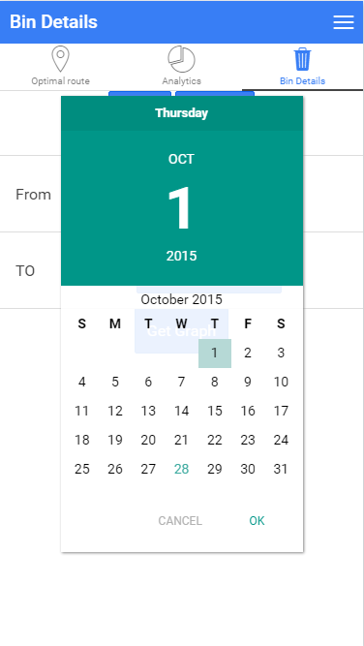
garboClean
Analytics is available for Supervisors
Generate analytics/ for the Bin for any Period

Slide 13
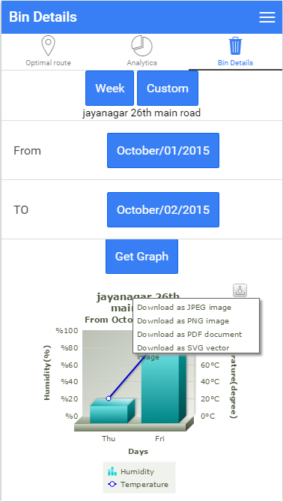
garboClean
Ability Download reports

Slide 14
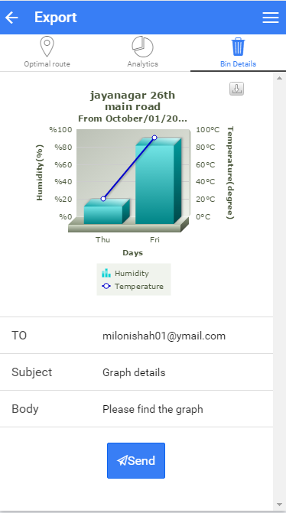
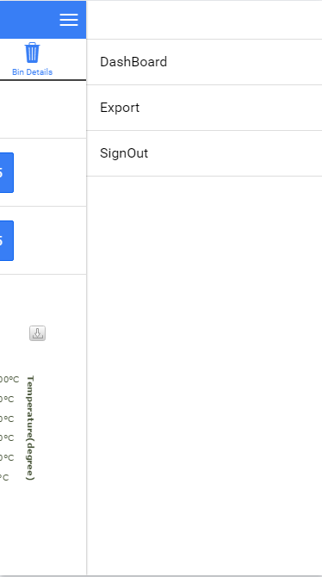
garboClean
Email reports

Slide 15
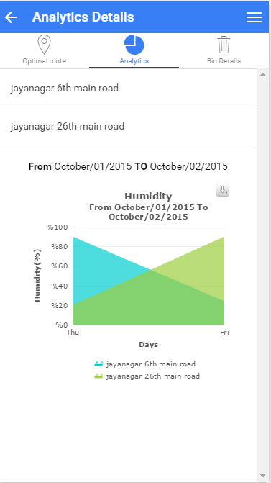
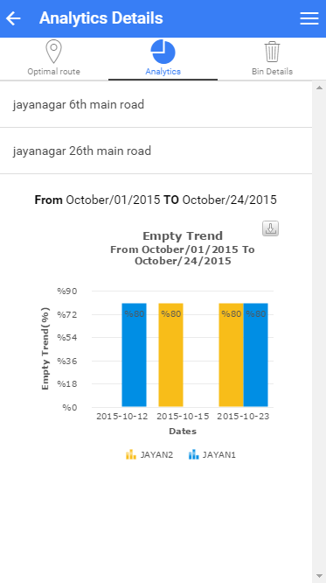
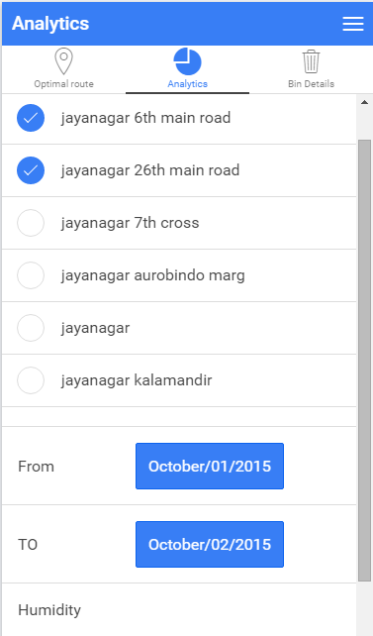
garboClean
Predictive Analytics – Empty Trend and Fill trends for Smart Planning based on historic backlog
Notes:
[‎11/‎1/‎2015 12:43 PM] Anil Jariwala, Anisha:
To plot empty trend at a time only 2 bins can be selected

Slide 16
garboClean
dump cleaner for smart cities
Thank You!

Slide 17
Appendix

Slide 18
garboClean
dump cleaner for smart cities
Please refer to Chipbin Solution Blueprint in gitHub code repository for Technical Details and Database setup

